Slide 1
A PRESENTATION
ON
“ARTIFICIAL INTELLIGENCE RECRUITER”
(Using IBM Watson Assistant)
BY
TEAM NAME: TEAM STAR
TEAM HEAD: P. SAI SAVITHRU MOHAN
UNDER THE GUIDANCE OF
SMART BRIDGE

Slide 2
OVERVIEW
Introduction
Working
Advantages
Disadvantages
Conclusion

Slide 3

AI RECRUITER

Slide 4
INTRODUCTION
AI Recruiter is an Artificial Intelligence enabled system that can interact with candidates and builds conversation and judges the worth of the candidate.
AI Recruiter uses IBM Watson Assistant.
Candidates can interact with Assistant and answer the questions raised.

Slide 5
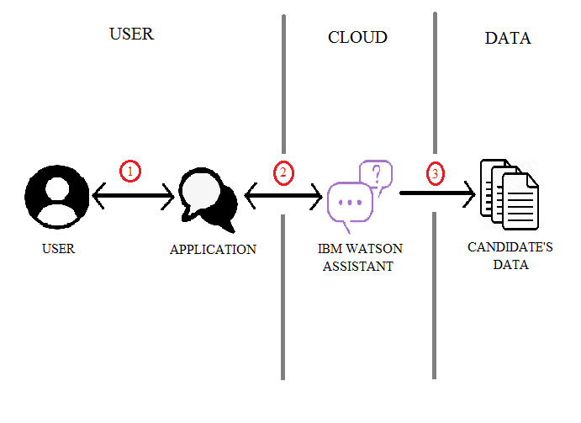
WORKING

Slide 6
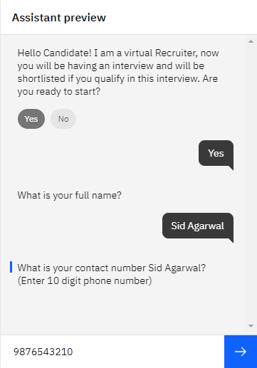
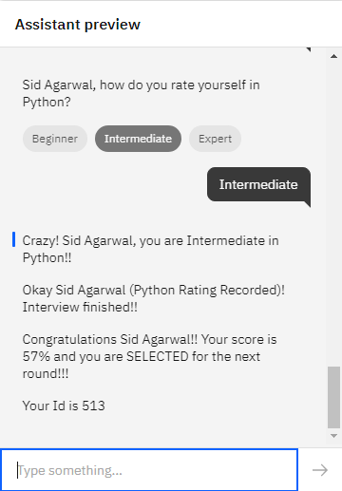
6

Slide 7
ADVANTAGES
It is cost-efficient.
Candidates can share their info as they do with human recruiters.
Reduce the involvement of human recruiters.
It reduces the time needed to screen candidates.
It can take its own decision depending upon the score of the candidate.
It reduces human recruiters’ effort.

Slide 8
DISADVANTAGES
Sometimes it does not work properly due to clash between the words in different intents.
Sometimes these can be manipulated if the working of this model is known.
It does not consider human emotions.
Jobs for humans, especially recruiters may be decreased.
Lack of standardization in human text.

Slide 9

CONCLUSION
For high volume recruitments, organizations need to interview a large group to select the right candidate. AI Recruiters can serve this purpose and can interact with candidates in very short time and helps in selecting the right candidate with ease.
IBM Watson Assistant keeps the candidate interested with its ability to understand candidate’s input and then respond accordingly.

Slide 10

REFERENCES
https://cloud.ibm.com/
https://ideal.com/recruitment-chatbot/
https://youtube.com/ (IBM Channel & SmartBridge Channel)

Slide 11


